Slide 1
13
Return, Risk, and the Security Market Line

Slide 2

Chapter 13 – Index of Sample Problems
Slide # 02 - 03 Expected return of individual stock
Slide # 04 - 05 Standard deviation of individual stock
Slide # 06 - 07 Portfolio weights
Slide # 08 - 18 Portfolio expected return
Slide # 19 - 22 Portfolio standard deviation
Slide # 23 - 26 Portfolio beta
Slide # 27 - 32 Capital asset pricing model
Slide # 33 - 35 Reward-to-risk ratio

Slide 3
2: Expected return of individual stock
You own 500 shares of ABC, Inc. This stock has the following expected returns given the various possible states of the economy.
State of Probability of Rate of Return
Economy State of Economy if State Occurs
Boom .20 28%
Normal .70 12%
Recession .10 -40%
What is your expected return on this stock?

Slide 4
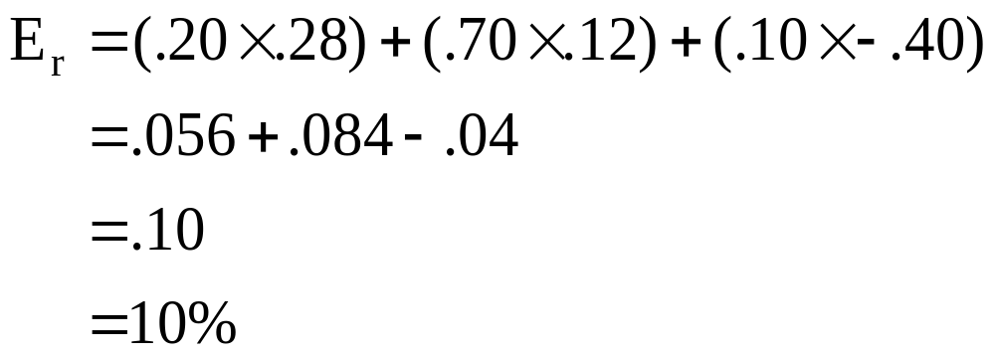
3: Expected return of individual stock

Slide 5
4: Standard deviation of individual stock
A stock has returns of 6.8%, 9.2%, -4.3% and 18.7% over the last four years, respectively.
What is the standard deviation of this stock assuming the returns are normally distributed?

Slide 6
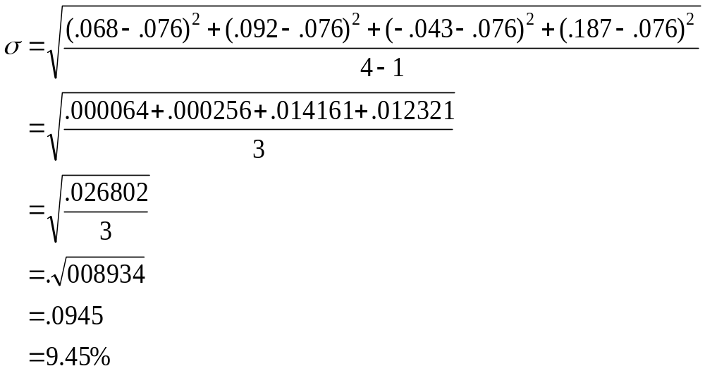
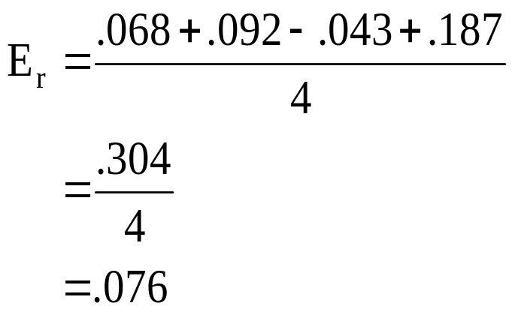
5: Standard deviation of individual stock

Slide 7
6: Portfolio weights
You own 50 shares of Stock A and 200 shares of stock B. Stock A sells for $30 a share and stock B sells for $22 a share.
What are the portfolio weights for each stock?

Slide 8
7: Portfolio weights
Stock Number of Price per Total Portfolio
Shares Share Value Weight
A 50 $30 $1,500 25.4%
B 200 $22 $4,400 74.6%
Totals $5,900 100.0%

Slide 9
8: Portfolio expected return
You have $3,600 invested in stock A and $5,400 invested in stock B. Stock A has an expected return of 11% and stock B has an expected return of 7%.
What is the expected return of your portfolio?

Slide 10
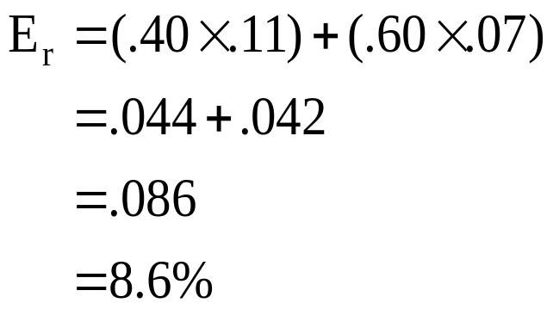
9: Portfolio expected return
Stock Expected Return Amount Invested Portfolio Weight
A 11% $3,600 40%
B 7% $5,400 60%
Totals $9,000 100%

Slide 11
10: Portfolio expected return
Your portfolio consists of the following stocks:
Stock Expected Return Number of Shares Stock Price
A 9% 640 $25
B 14% 250 $40
C 7% 700 $20
What is the expected return on your portfolio?

Slide 12
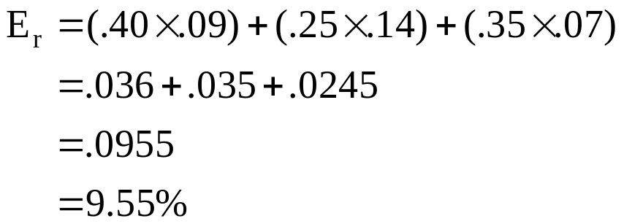
11: Portfolio expected return
Expected Number Price Stock Portfolio
Stock Return of Shares per Share Value Weight
A 9% 640 $25 $16,000 40%
B 14% 250 $40 $10,000 25%
C 7% 700 $20 $14,000 35%
Totals $40,000 100%

Slide 13
12: Portfolio expected return
You have a portfolio with an expected return of 12.94%. Your portfolio consists of stock A and stock B only. Stock A has an expected return of 18% and stock B has an expected return of 7%.
What are the portfolio weights?

Slide 14
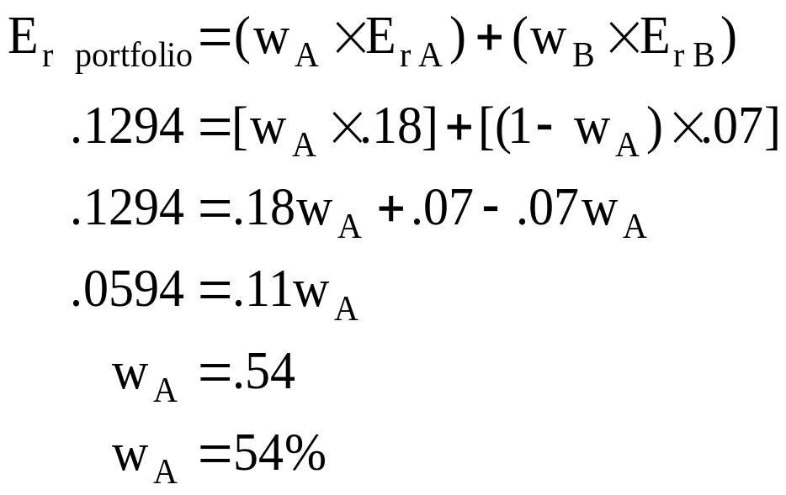
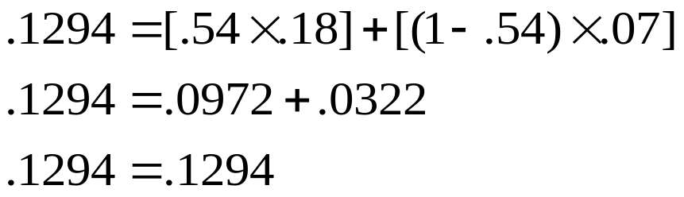
13: Portfolio expected return

Slide 15
14: Portfolio expected return
State of Probability of Rate of Return
Economy State of Economy if State Occurs
Boom .15 18%
Normal .60 11%
Recession .25 2%
What is the expected return on this portfolio?

Slide 16
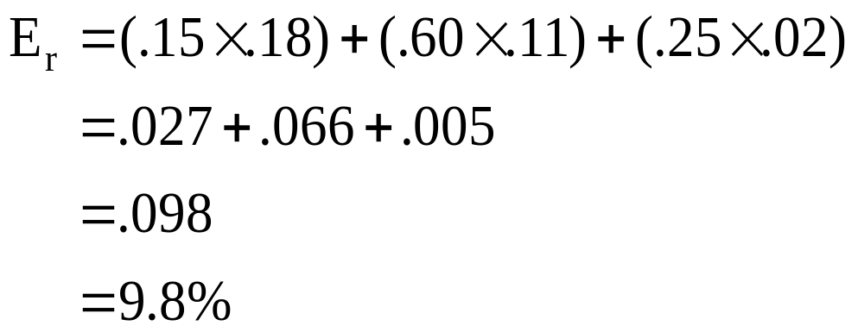
15: Portfolio expected return

Slide 17
16: Portfolio expected return
State of Probability of Rate of Return if State Occurs
Economy State of Economy Stock A Stock B Stock C Boom .20 17% 13% 40%
Normal .50 8% 6% 13%
Recession .30 -12% -5% -50%
Your portfolio consists of 50% stock A, 40% stock B and
10% stock C.
What is the expected return on your portfolio?

Slide 18
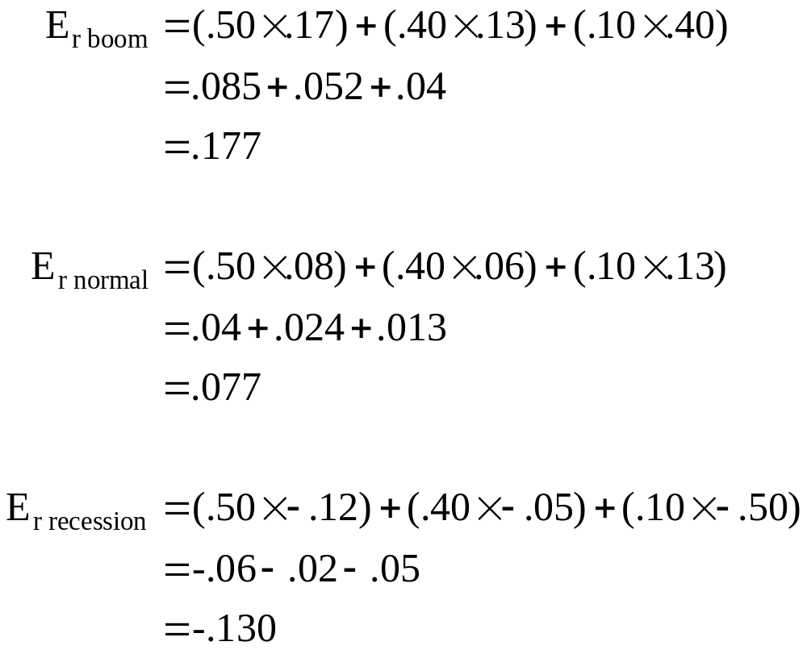
17: Portfolio expected return

Slide 19
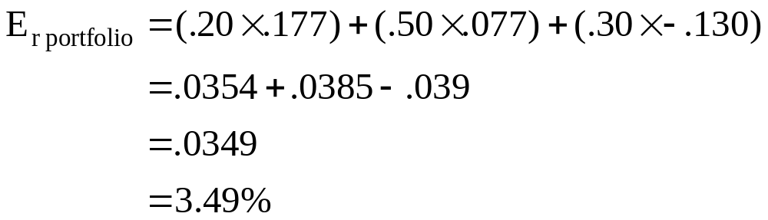
18: Portfolio expected return
State of Probability of Expected Return
Economy State of Economy if State Occurs
Boom .20 . 177
Normal .50 .077
Recession .30 -.130

Slide 20
19: Portfolio standard deviation
State of Probability of Rate of Return if State Occurs
Economy State of Economy Stock A Stock B Stock C Boom .10 24% 5% 14%
Normal .70 11% 6% 9%
Recession .20 -30% 7% -5%
Your portfolio consists of 30% stock A, 50% stock B and
20% stock C.
What is the standard deviation of your portfolio?

Slide 21
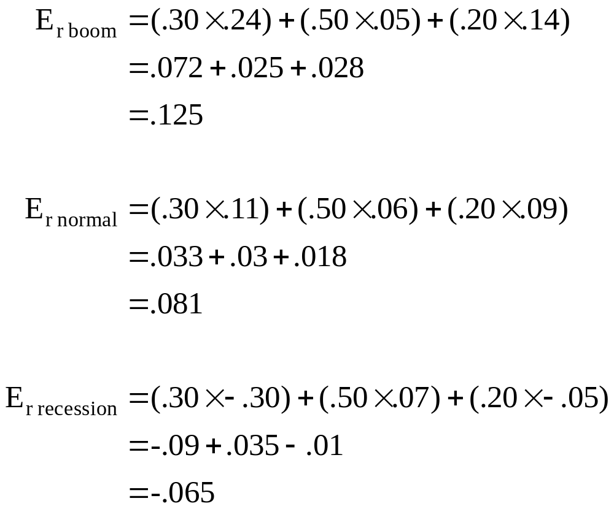
20: Portfolio standard deviation

Slide 22
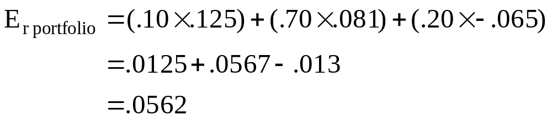
21: Portfolio standard deviation
State of Probability of Expected Return
Economy State of Economy if State Occurs
Boom .10 . 125
Normal .70 .081
Recession .20 -.065

Slide 23
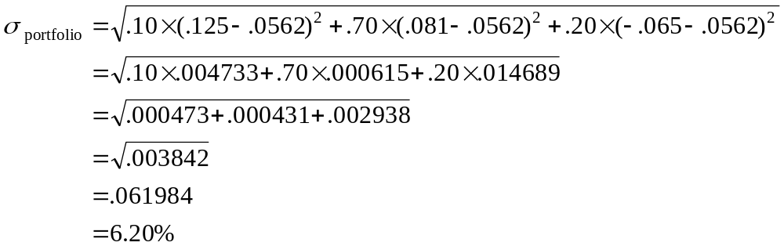
22: Portfolio standard deviation
State of Probability of Expected Return
Economy State of Economy if State Occurs
Boom .10 . 125
Normal .70 .081
Recession .20 -.065
Portfolio expected return = .0562

Slide 24
23: Portfolio beta
Your portfolio consists of the following stocks:
Stock Portfolio Weight Beta
A 20% .76
B 30% 1.89
C 40% 1.05
D 10% .34
What is the beta of your portfolio?

Slide 25
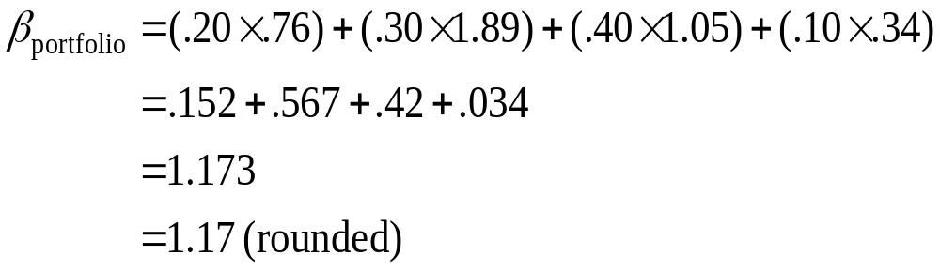
24: Portfolio beta

Slide 26
25: Portfolio beta
You want to create a portfolio that has a risk level equal to the overall market. Your portfolio will consist of the following securities:
Security Portfolio Weight Beta
Stock A ? 1.4
Treasury bills ? ?
What do the portfolio weights need to be?

Slide 27
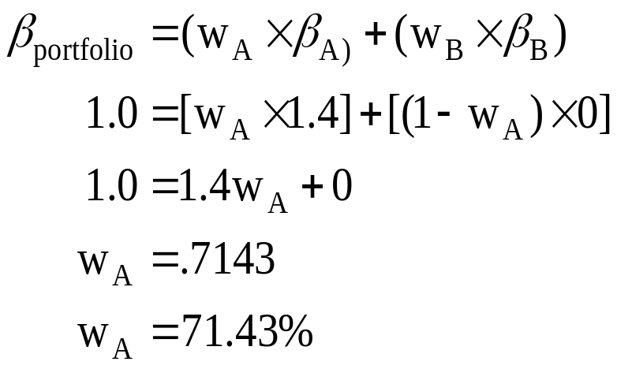
26: Portfolio beta
Weight of Stock A = 71.43%
Weight of Treasury bills = 100% - 71.43% = 28.57%

Slide 28
27: Capital asset pricing model
You own shares of Big Burgers, Inc. This stock has a beta of 1.24. U.S. Treasury bills are returning 3.4%. The return on the market is 11.4%.
What is the expected return on Big Burgers, Inc.?

Slide 29
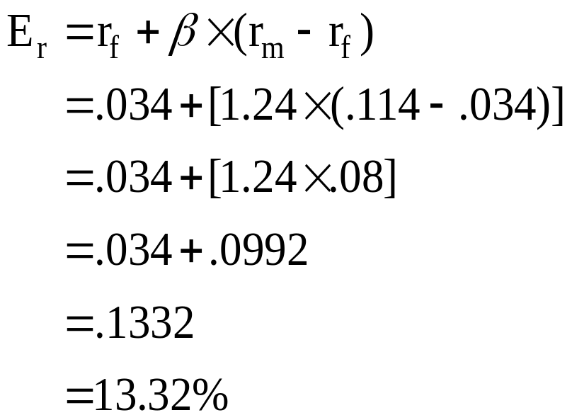
28: Capital asset pricing model

Slide 30
29: Capital asset pricing model
You own shares of International Coffees. The expected return on this stock is 16%. The risk-free rate is 3% and the market risk premium is 7%.
What is the beta of the International Coffees stock?

Slide 31
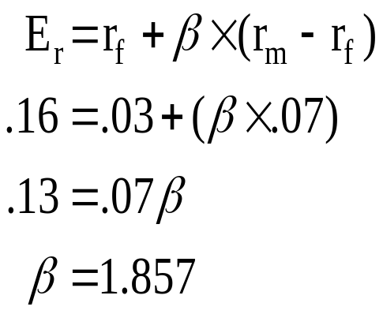
30: Capital asset pricing model

Slide 32
31: Capital asset pricing model
A stock has a beta of .86 and an expected return of 13.5%. The risk-free rate is 4%.
What is the expected return on the market?

Slide 33
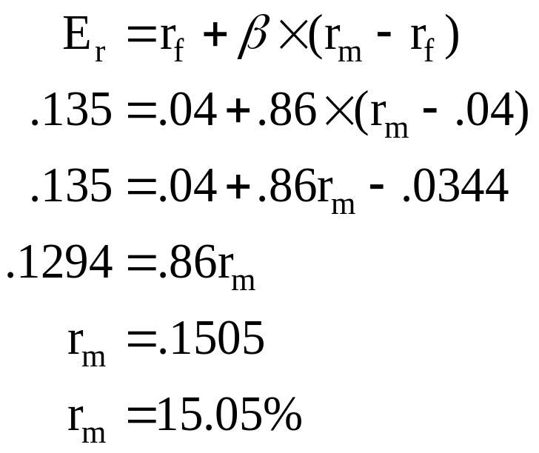
32: Capital asset pricing model

Slide 34
33: Reward-to-risk ratio
Stock Beta Expected Return
A .42 6.6%
B 1.23 11.8%
C .89 9.8%
Are these stocks correctly priced if the risk-free rate is 3% and the market risk premium is 8%?

Slide 35
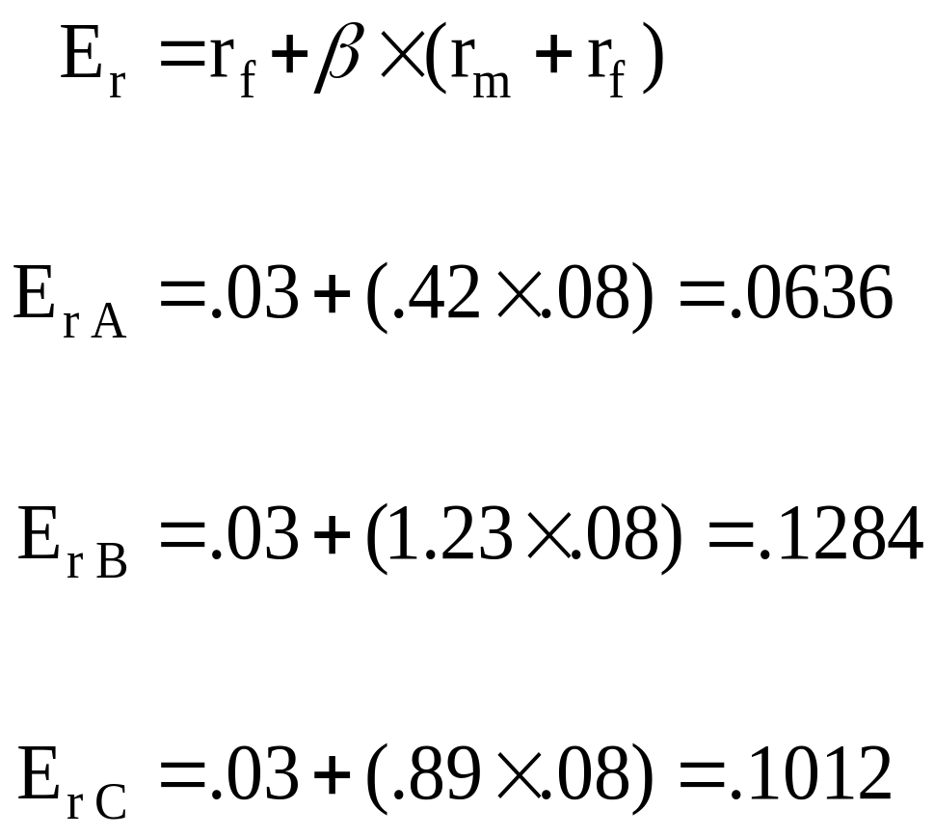
34: Reward-to-risk ratio

Slide 36
35: Reward-to-risk ratio
Expected CAPM Stock
Stock Return Return Pricing
A 6.6% 6.36% underpriced
B 11.8% 12.84% overpriced
C 9.8% 10.12% overpriced

Slide 37
13
End of Chapter 13

